Slide 1
Banking System
C Programming
IIITDM Kurnool
{
< File-Handling Based Console Application >
}
...
Group Members: ASHWIN 125AD0039 | PARTHA 125AD0035 | MANYANTA 525ME0009 | VASU 125CS0044 | ANSHUMAN 125EC0037

Slide 2
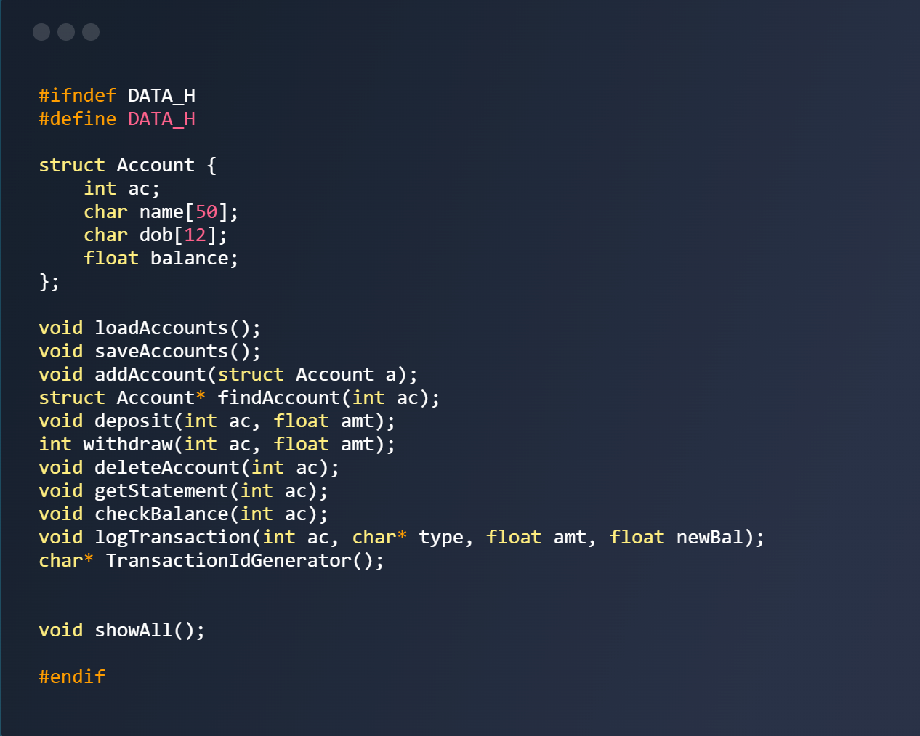
#include Files
#include <data.h>
[Functions Declared in Header]
data.h handles all structure and functions declarations so main.c and data.c can work together.
It acts as a bridge of the project, defining what system can do before code executes it.

Slide 3
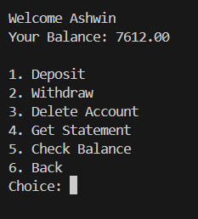
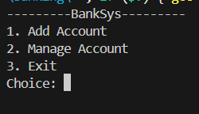
Start Menu & Manage Menu.
Start Menu: Displays the main options like adding an account, managing an account, viewing logs, or exiting the system.
Manage Menu: Shows actions for a specific user such as deposit, withdraw, delete account, and viewing statements.

Slide 4
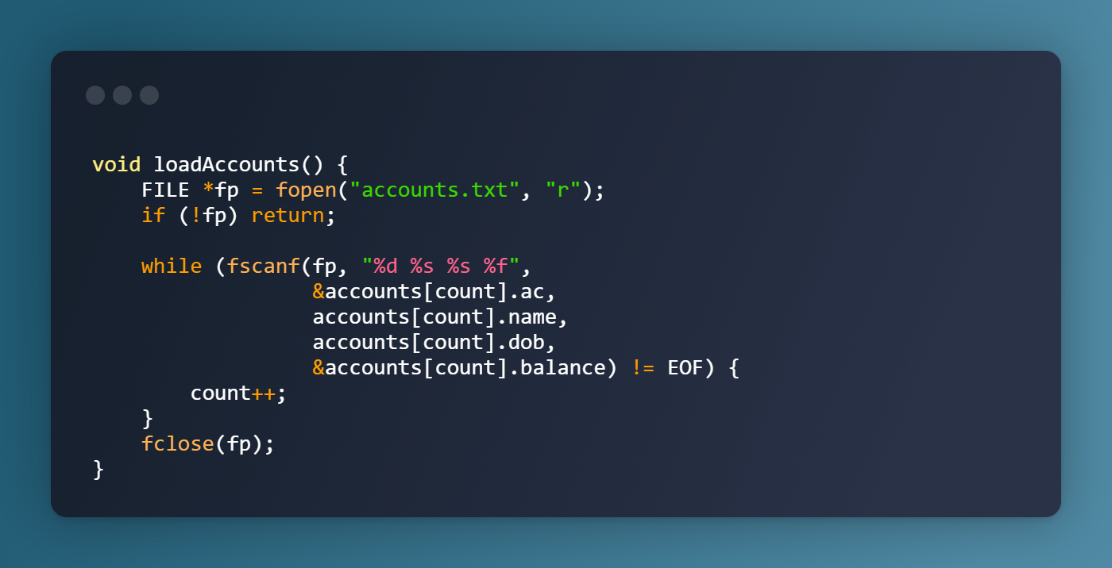
void loadAccounts();
1️⃣ File is like memory of past — fopen opens accounts.txt and fscanf reads every stored account (ac, name, dob, balance) one by one, filling them back into the program so nothing from past is forgotten.
2️⃣ Life keeps moving count forward — every successful read increases count, meaning each recovered account becomes part of the present list again before closing the file.

Slide 5
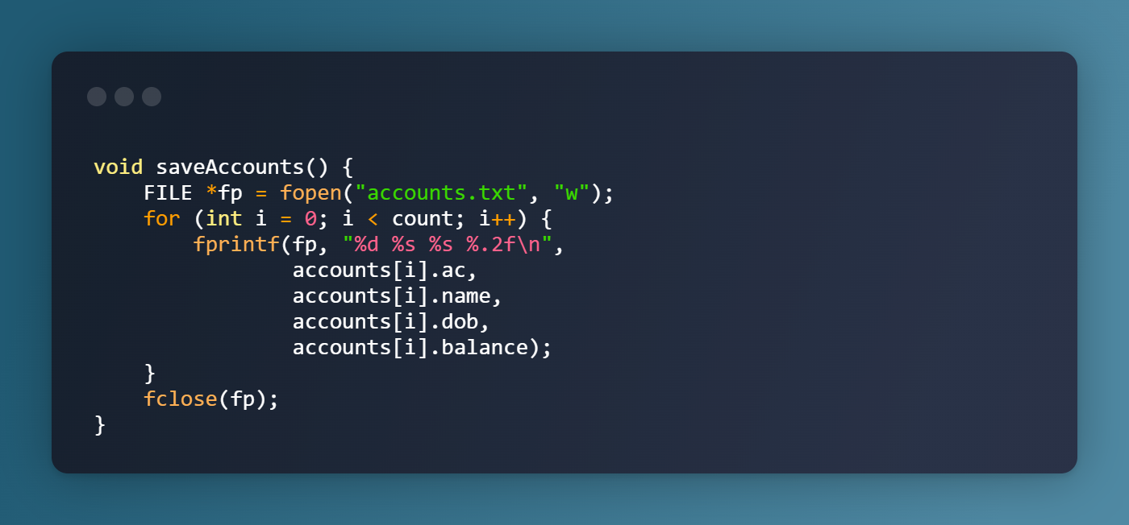
void saveAccounts();
1️⃣ Writing is preservation — fopen with "w" erases old content and fprintf rewrites every account, turning program data into permanent memory on the disk.
2️⃣ Loop of existence — the for loop travels from 0 to count, ensuring every account gets recorded before the file is closed, just like every moment must be acknowledged before life moves on.

Slide 6
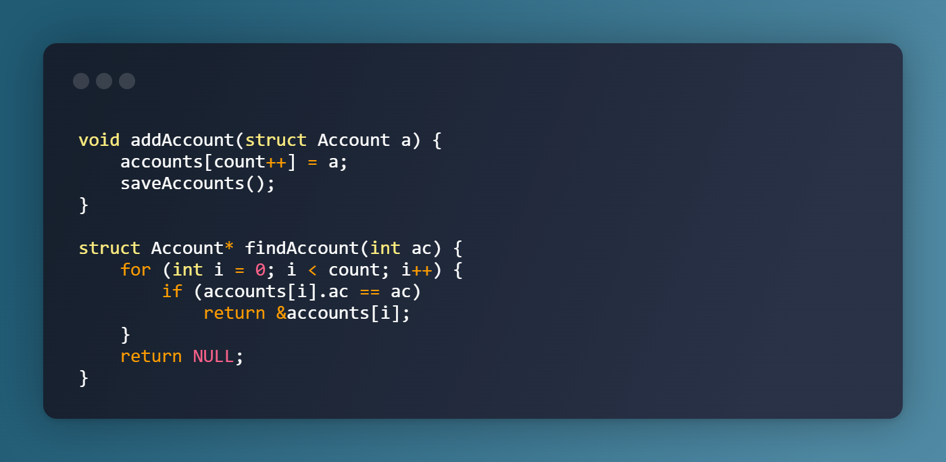
void addAccount(struct Account a) & struct Account* findAccount(int ac)
🔹 addAccount() — adds the new account into system and instantly saves it, showing that every new beginning deserves to be preserved.
🔹 findAccount() — searches every stored record and returns the matching one, reminding that answers appear only when we look deeply.

Slide 7
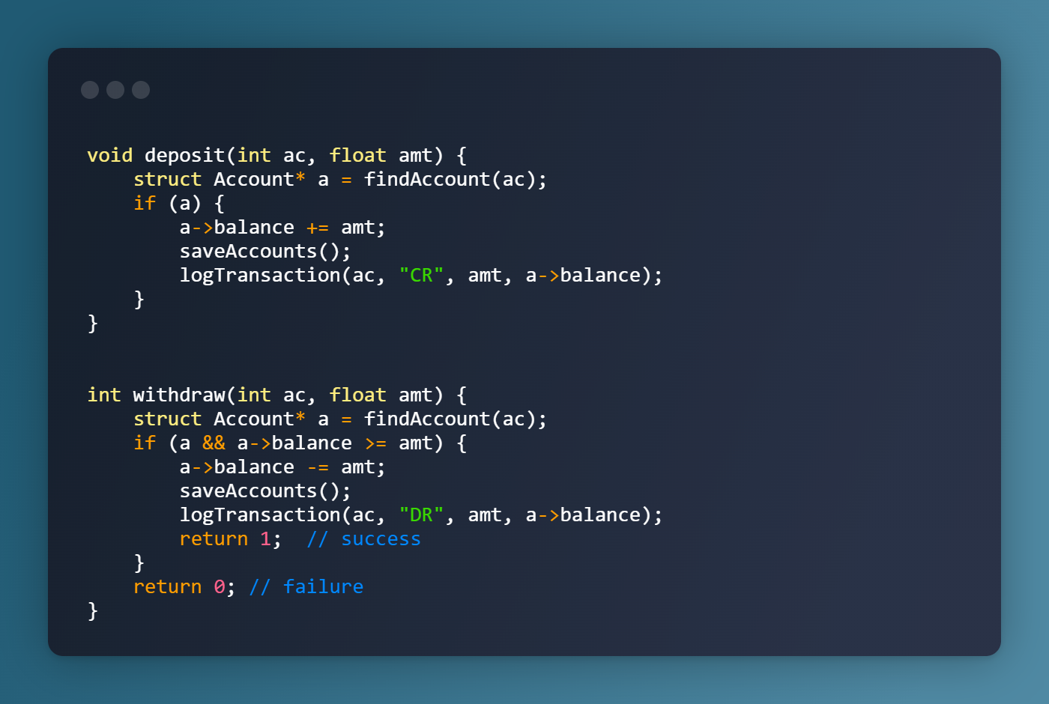
int withdraw(int ac, float amt) & void deposit(int ac, float amt)
🔹 deposit() — increases the account balance and records it, teaching that adding value to life must always be remembered.
🔹 withdraw() — deducts only when there is enough balance, reminding that life allows us to take only what we have earned.

Slide 8
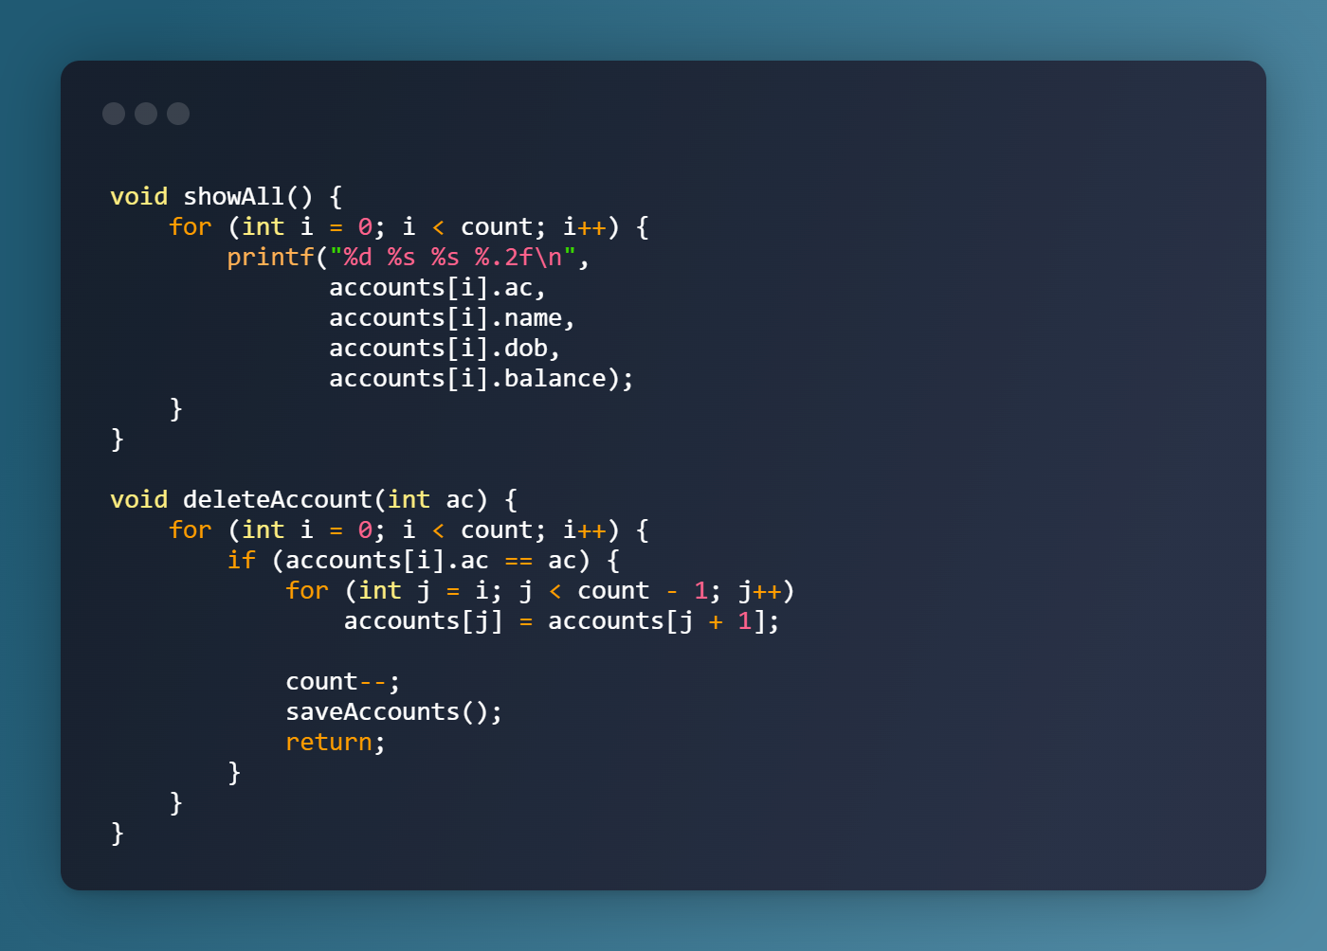
void showAll() & void deleteAccount(int ac)
🔹 showAll() — prints every stored account, reminding that transparency brings clarity when all truths are placed in front of us.
🔹 deleteAccount() — removes the matched account and shifts others to fill the gap, showing that when someone leaves, life rearranges itself and continues.

Slide 9
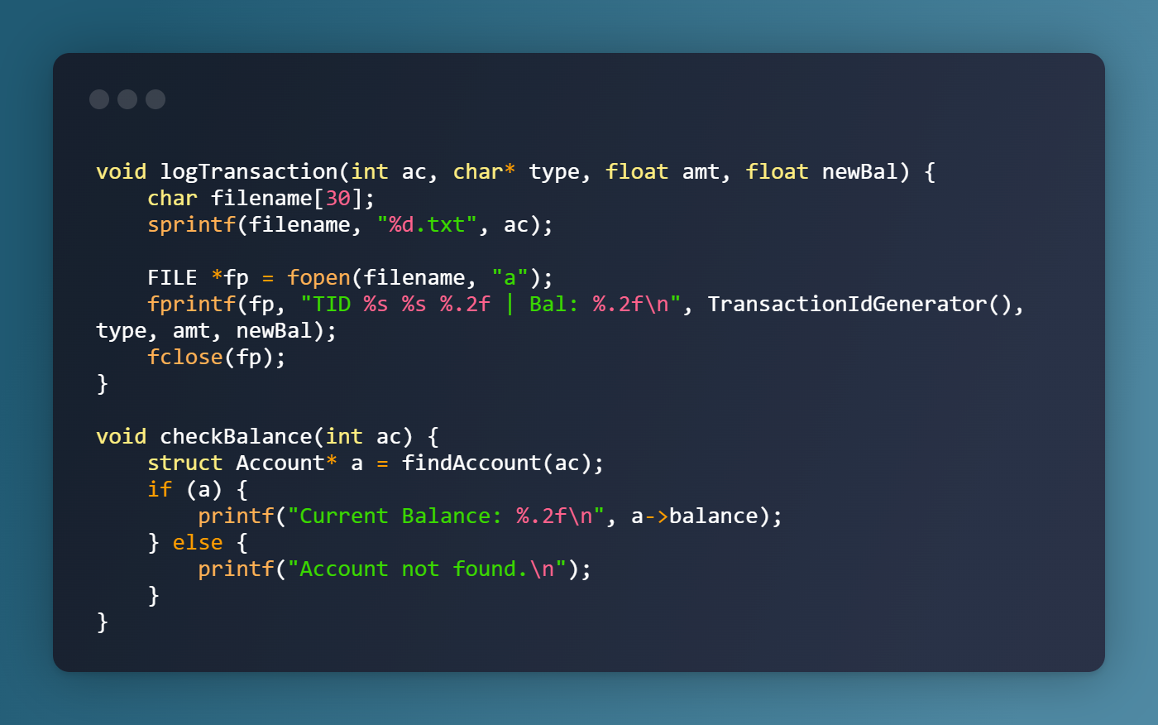
void logTransaction() & void checkBalance(int ac)
🔹 logTransaction() — records every credit/debit into a personal file, teaching that every action leaves a trace and nothing in life happens without a footprint.
🔹 checkBalance() — shows the balance if the account exists, proving that clarity comes only when identity is real, otherwise the search ends in emptiness.

Slide 10
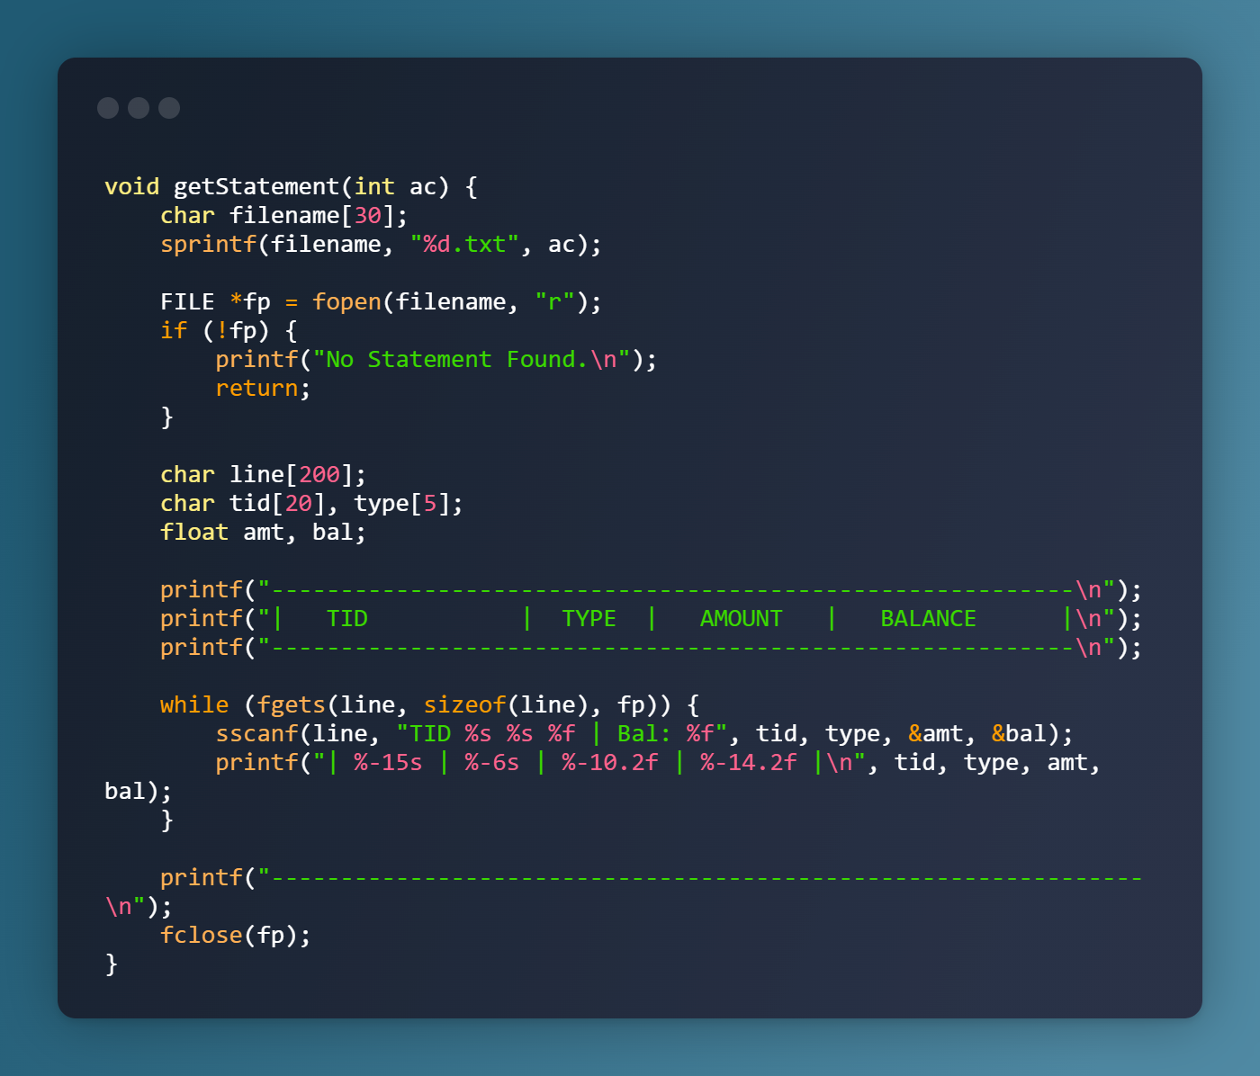
void getStatement(int ac)
1️⃣ getStatement() opens the transaction file and prints each entry in a table format, showing every financial step taken.
2️⃣ It teaches that the past can’t be erased — every credit and debit resurfaces when we choose to look back.

Slide 11
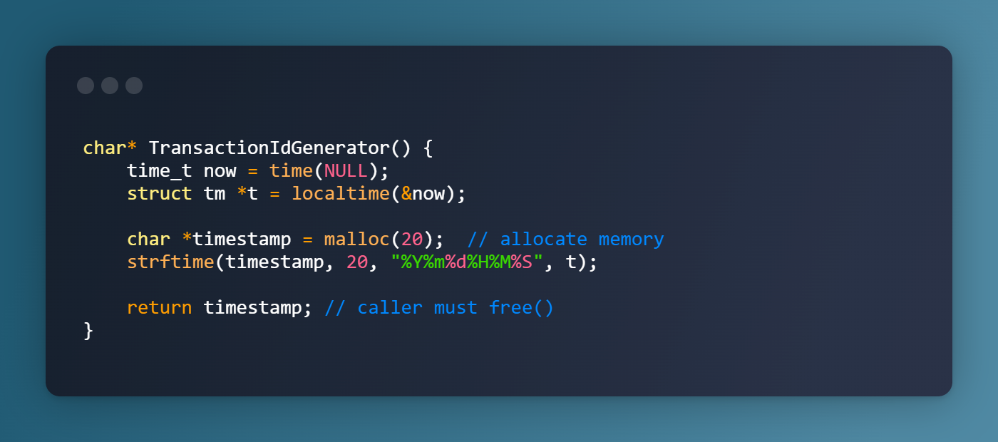
char* TransactionIdGenerator()
1️⃣ Generates a unique ID from the current date and time, reminding that every moment in life arrives only once and becomes its own identity.
2️⃣ Allocates memory and returns the timestamp, teaching that whatever we create must eventually be released, or it becomes a burden we carry.

Slide 12
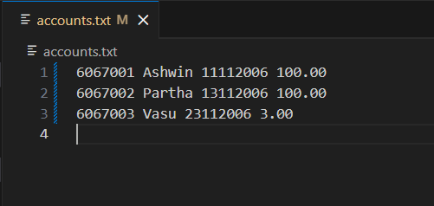
#accounts Keeping
accounts.txt
accounts.txt stores all account records permanently, including AC number, name, DOB, and balance.
It works as the system’s main database, allowing the program to load, update, and save user data using file handling in C.

Slide 13
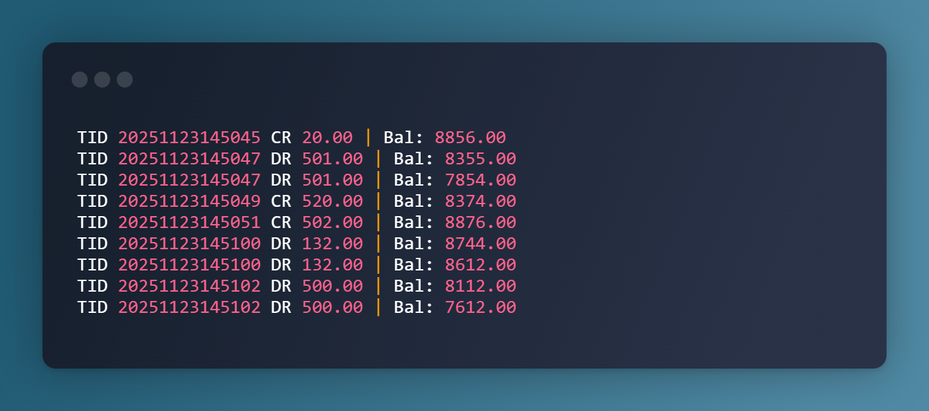
#A/c statement Keeping
6067001.txt
Each account gets its own statement file named after the account number.
It records every deposit and withdrawal with updated balance using file appending.
It acts as the user’s transaction history, showing the complete financial trail.

Slide 14
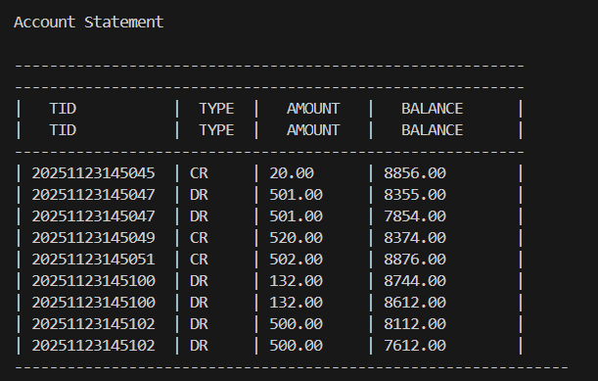
#A/c statement Checking

Slide 15

Thankyou!
{
}
< Scan the QR Code Below to Open GitHub Rep of this Project>
Credits :
Ashwin Jain 125AD0039
Partha Biswas 125AD0035
Vasu Jangid 125CS0062
Manyata 525ME0009
Anshuman 125EC0037

